Slide 1
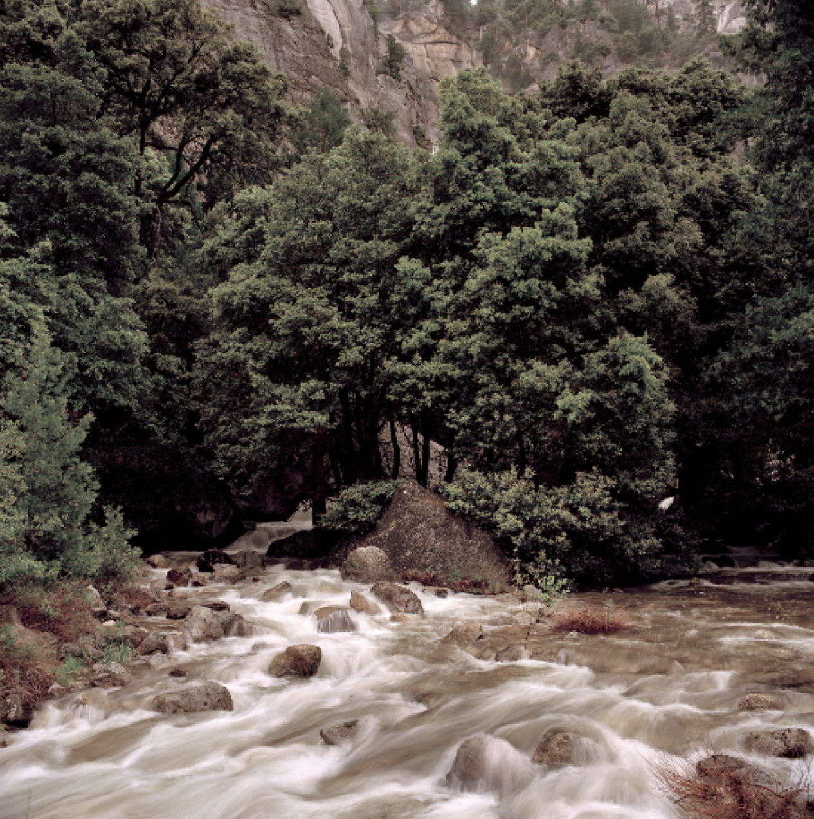
Flood-MAR Update Presentation
Prepared by: Team #25
Matthew Chen, Ava Lancaster, Lily Langes, and Fatima Segoviano

Slide 2
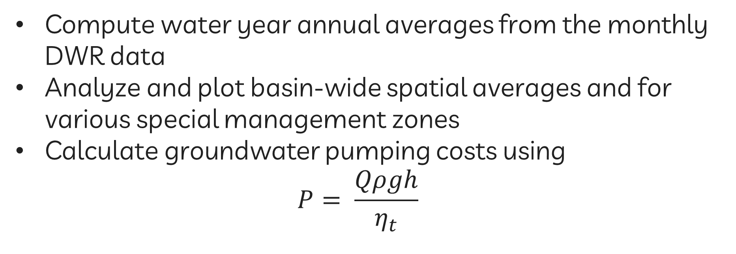
Methodology
Compute water year annual averages from the monthly DWR data
Analyze and plot basin-wide spatial averages and for various special management zones
Calculate groundwater pumping costs using
$$P= \frac{Qρgh}{η_{t}}$$
Notes:
Pump hydraulic power equation

Slide 3
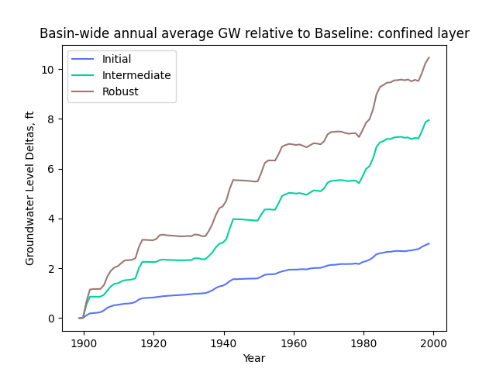
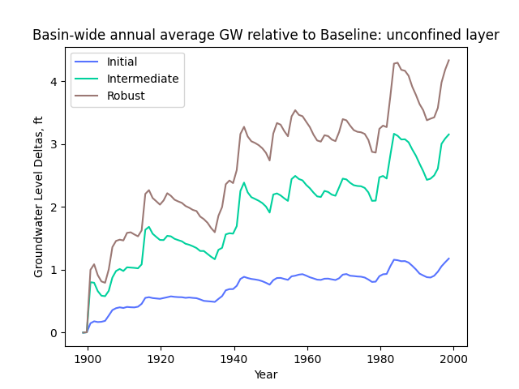
Metric: Water Supply Reliability

Slide 4
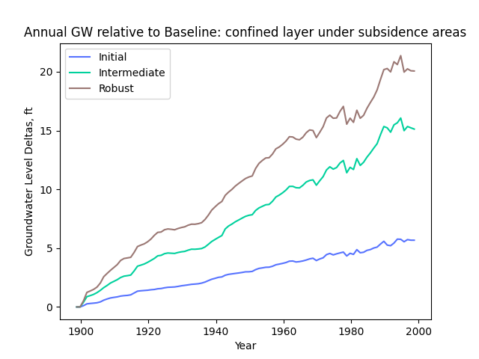
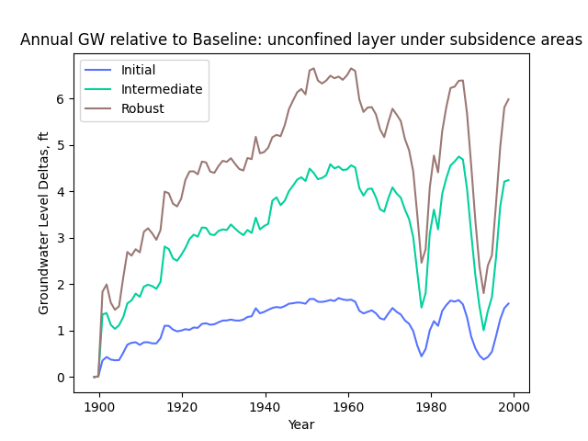
Metric: Subsidence Zones

Slide 5
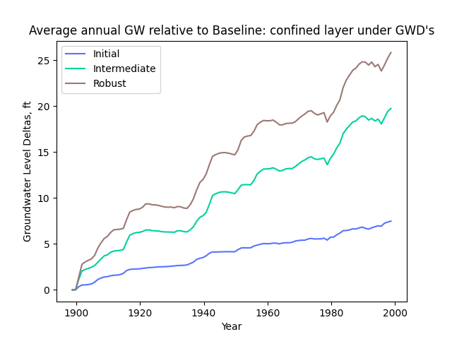
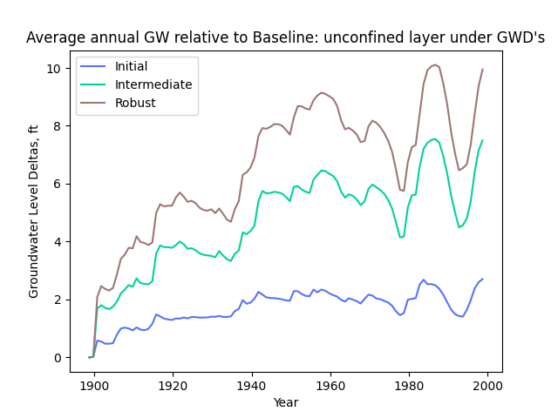
Metric: Groundwater Dependent Communities

Slide 6
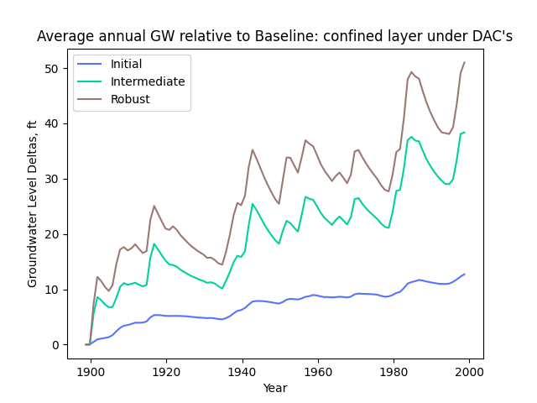
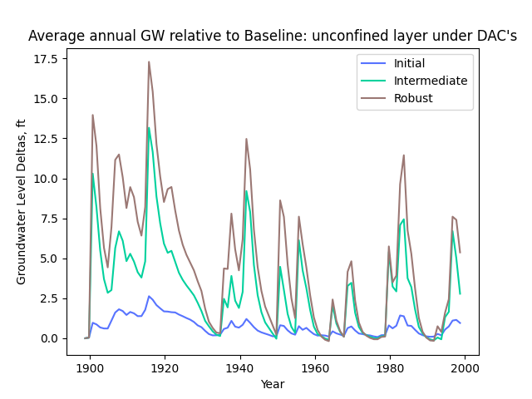
Metric: Disadvantaged Communities

Slide 7
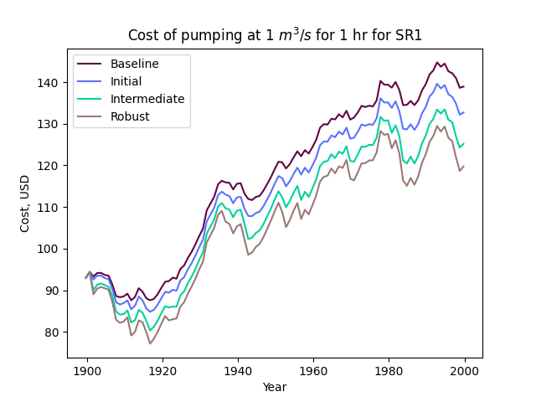
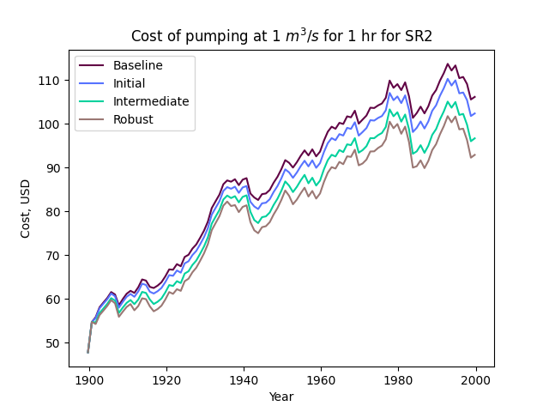
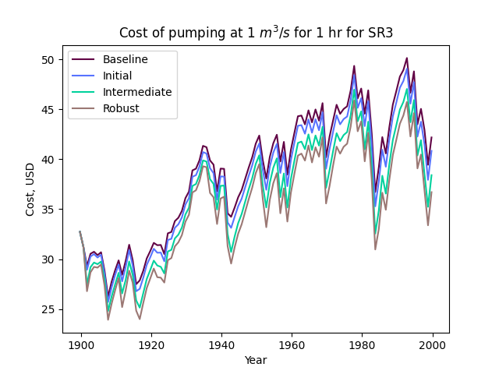
Metric: Pumping Cost

Slide 8
Moving Forward Plan
Interpretation of results
SGMA intergration
Final Report
Final Presentation/Showcase
Notes:
What other things we can add…

Slide 9
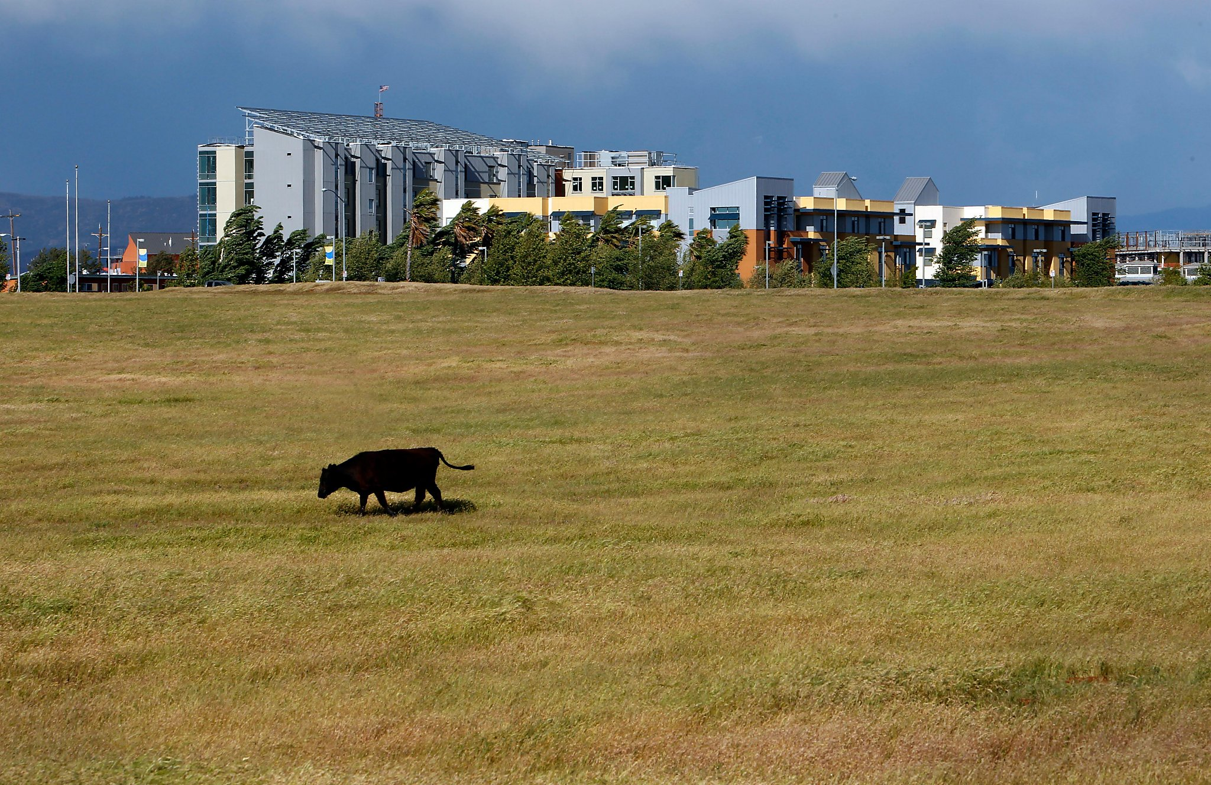
THANK YOU

